Slide 1

Microprogram sequencing. Pipelining & Parallel Processing: pipeline structure
Computer Organization and Architecture | Hardwired and Microprogrammed Control
Course: Computer Organization and Architecture | Chapter: Hardwired and Microprogrammed Control | Program: Bachelor of Engineering
DISCOVER · LEARN · EMPOWER
Notes:
Welcome everyone to today's lecture on Microprogram sequencing and pipeline structures. We are focusing specifically on how control units manage instruction flow within the Hardwired and Microprogrammed Control chapter. This session will bridge the gap between control logic and high-performance pipelining techniques.

Slide 2
Course Outcomes
SLIDE 2 / 10
Course Outcome
CO | BT LEVEL | DESCRIPTION
CO1 | BT3 | Apply number systems and digital logic to design basic digital circuits
CO2 | BT4 | Analyze register organization and instruction set architecture
CO3 | BT3 | Implement computer arithmetic algorithms and floating-point operations
CO4 | BT5 | Analyze memory hierarchy and input-output organization
CO5 | BT6 | Evaluate control unit design and pipelining performance
Chandigarh University
2 / 10
Notes:
Today's lecture is directly mapped to Course Outcome 5. You will learn to evaluate how different control unit designs impact the overall performance of a pipelined processor. This involves analyzing the trade-offs between hardwired and microprogrammed approaches in a pipeline context.

Slide 3
Learning Objectives
SLIDE 3 / 10
Learning Outcomes
1
Analyze the role of sequencing logic in microprogrammed control units.
2
Evaluate the impact of control signals on pipeline stage synchronization.
3
Differentiate between hardwired and microprogrammed sequencing mechanisms.
4
Assess performance metrics for pipeline structures under various control schemes.
Chandigarh University
3 / 10
Notes:
By the end of this session, you will be able to analyze how sequencing logic dictates the flow of microinstructions. We will evaluate how control signals must synchronize with pipeline stages to prevent hazards. You will also differentiate between the two main control unit types and assess their performance impacts.

Slide 4
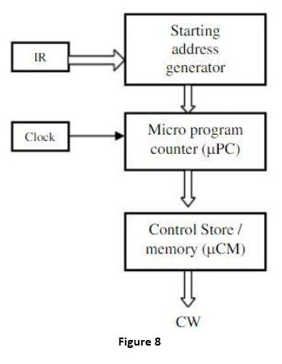
Lecture
SLIDE 4 / 10
Microprogram Sequencing Logic
1
Sequencing logic determines the address of the next microinstruction to execute.
2
It uses a Microprogram Counter (μPC) to track the current microinstruction address.
3
Next address logic can be sequential, conditional, or based on instruction decoding.
4
Sequencing must align with the instruction cycle to ensure correct control flow.
5
Microprogrammed control allows flexible sequencing via a control store lookup mechanism.
Explain with diagram functioning of Micro programmed Control Unit.
Chandigarh University
4 / 10
Notes:
Think of the Microprogram Counter as the program counter for microcode, just like a PC is for machine code. It points to the next microinstruction in the control store. If an instruction requires a branch, the sequencing logic calculates the new address based on status flags. This flexibility is key to handling complex instructions in a pipeline.

Slide 5
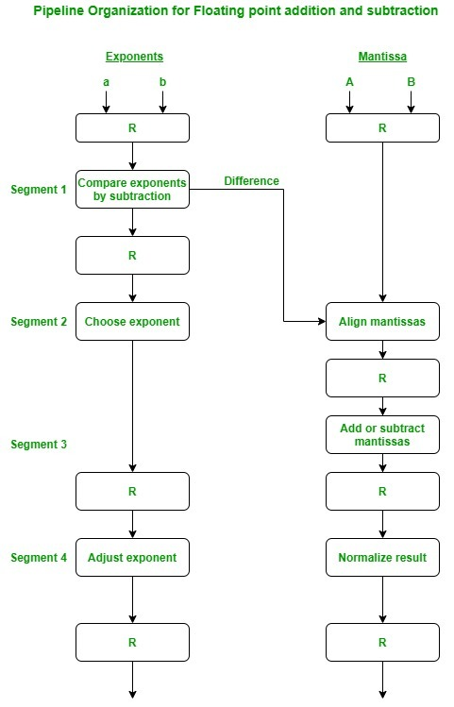
Lecture
SLIDE 5 / 10
Pipeline Structure Fundamentals
1
A pipeline divides instruction processing into distinct stages like Fetch, Decode, Execute.
2
Each stage performs a specific task and passes results to the next stage.
3
Pipelining increases throughput by allowing multiple instructions to be processed simultaneously.
4
The pipeline structure relies on synchronized control signals from the control unit.
5
Ideal pipeline depth balances stage complexity with clock cycle time constraints.
Arithmetic Pipeline and Instruction Pipeline - GeeksforGeeks (source: media.geeksforgeeks.org)
Chandigarh University
5 / 10
Notes:
Imagine an assembly line where each worker does one specific task. In a CPU pipeline, the Fetch stage grabs an instruction while the Execute stage processes a previous one. This overlap is what boosts throughput. However, the control unit must generate signals that are perfectly timed for each stage to avoid collisions.

Slide 6
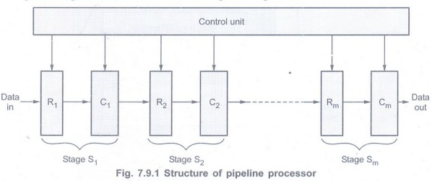
Lecture
SLIDE 6 / 10
Sequencing in Pipelined Control Units
1
Microprogrammed control units can dynamically adjust sequencing for pipeline hazards.
2
Hardwired control units use fixed logic for faster but less flexible sequencing.
3
Sequencing logic must handle control hazards like branches and jumps efficiently.
4
Pipeline flushes require specific sequencing signals to clear the instruction queue.
5
Dynamic sequencing allows for better handling of variable-length instruction sets.
Pipelined Datapath and Control - Processor - Digital Principles and Computer Organization (source: www.poriyaan.in)
Chandigarh University
6 / 10
Notes:
When a branch occurs, the control unit must decide whether to wait or predict. Microprogrammed control can insert bubbles or flush the pipeline by changing the μPC address dynamically. Hardwired control does this with faster, fixed logic but lacks the flexibility to handle complex variable-length instructions as easily.

Slide 7
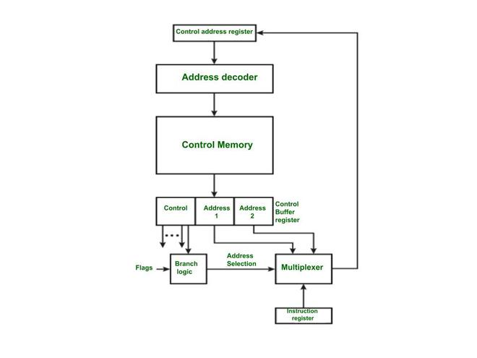
Lecture
SLIDE 7 / 10
Performance Evaluation Metrics
GOVERNING EQUATION
Speedup = (Time without pipeline) / (Time with pipeline)
1
Throughput is the number of instructions completed per unit of time.
2
Latency is the total time taken for a single instruction to complete.
3
Efficiency = (Actual Speedup) / (Number of pipeline stages).
4
Control unit overhead reduces the theoretical maximum speedup of the pipeline.
Micro Instruction Sequencing - GeeksforGeeks (source: media.geeksforgeeks.org)
Chandigarh University
7 / 10
Notes:
Let's look at the numbers. If a non-pipelined processor takes 100ns per instruction and a 5-stage pipeline takes 20ns per stage, the theoretical speedup is 5. However, control overhead might add 2ns, reducing the actual speedup. We evaluate the control unit design based on how much it impacts this efficiency.

Slide 8
Lecture
SLIDE 8 / 10
Control Hazards and Sequencing
1
Control hazards occur when the pipeline makes wrong branch predictions.
2
Sequencing logic must stall or flush the pipeline upon a branch misprediction.
3
Microprogrammed control can implement complex branch prediction algorithms easily.
4
Hardwired control uses simpler logic but may suffer more from mispredictions.
5
Correct sequencing ensures the pipeline resumes with the correct instruction stream.
Pipelined Datapath and Control - Processor - Digital Principles and Computer Organization (source: www.poriyaan.in)
Chandigarh University
8 / 10
Notes:
Imagine the pipeline is a train moving fast. If the track changes (a branch), the train must stop or switch tracks. A misprediction means the train went down the wrong track and had to stop and reverse. Microprogrammed control can handle complex switching logic, while hardwired control is like a fixed switch that is faster but less adaptable.

Slide 9
Lecture
SLIDE 9 / 10
Key Takeaways
1
Microprogram sequencing provides flexible control for complex pipeline operations.
2
Pipeline structures rely on synchronized control signals for high throughput.
3
Hardwired control offers speed, while microprogrammed control offers flexibility.
4
Sequencing logic must manage hazards to maintain pipeline efficiency.
5
Performance evaluation requires analyzing control overhead and speedup metrics.
Arithmetic Pipeline and Instruction Pipeline - GeeksforGeeks (source: media.geeksforgeeks.org)
Chandigarh University
9 / 10
Notes:
To summarize, microprogram sequencing gives us the flexibility to handle complex instructions in a pipeline. However, this comes with a trade-off in speed compared to hardwired control. The key is managing control hazards effectively to maintain the pipeline's throughput. Always evaluate the control unit design based on the specific performance requirements of your system.

Slide 10
Lecture
SLIDE 10 / 10
References
COMPUTER ORGANIZATION AND DESIGN
The Hardware/Software Interface — David A. Patterson, John L. Hennessy
COMPUTER ARCHITECTURE
A Quantitative Approach — John L. Hennessy, David A. Patterson
• Computer Organization and Architecture — William Stallings
• Computer System Architecture — M. Morris Mano & Rajib Mall
• Computer Organization — Carl Hamacher, Zvonko Vranesic, Safwat Zaky
Chandigarh University
10 / 10
Notes:
These five textbooks provide the foundational knowledge for the concepts discussed today. Stallings and Mano offer excellent coverage of control unit design. Patterson and Hennessy provide deep insights into performance evaluation and quantitative analysis. Please refer to these texts for further study on microprogrammed control and pipelining.

